Slide 1
Passage aggregation retrieval model (PARM) for dense document-to-document retrieval
Sophia Althammer
sophia.althammer@tuwien.ac.at
/sophiaalthammer

Slide 2
Today
Passage Aggregation Retrieval Model (PARM) for dense document-to-document retrieval
Dense Passage Retrieval Models
The BERT_{DOT} model
Nearest neighbor search
Passage Aggregation Retrieval Model (PARM)
Workflow
Experiments
Results
❶
❷

Slide 3
Dense Passage Retrieval Models
Slides by Sebastian Hofstätter
sebastian.hofstaetter@tuwien.ac.at
/s_hofstaetter

Slide 4
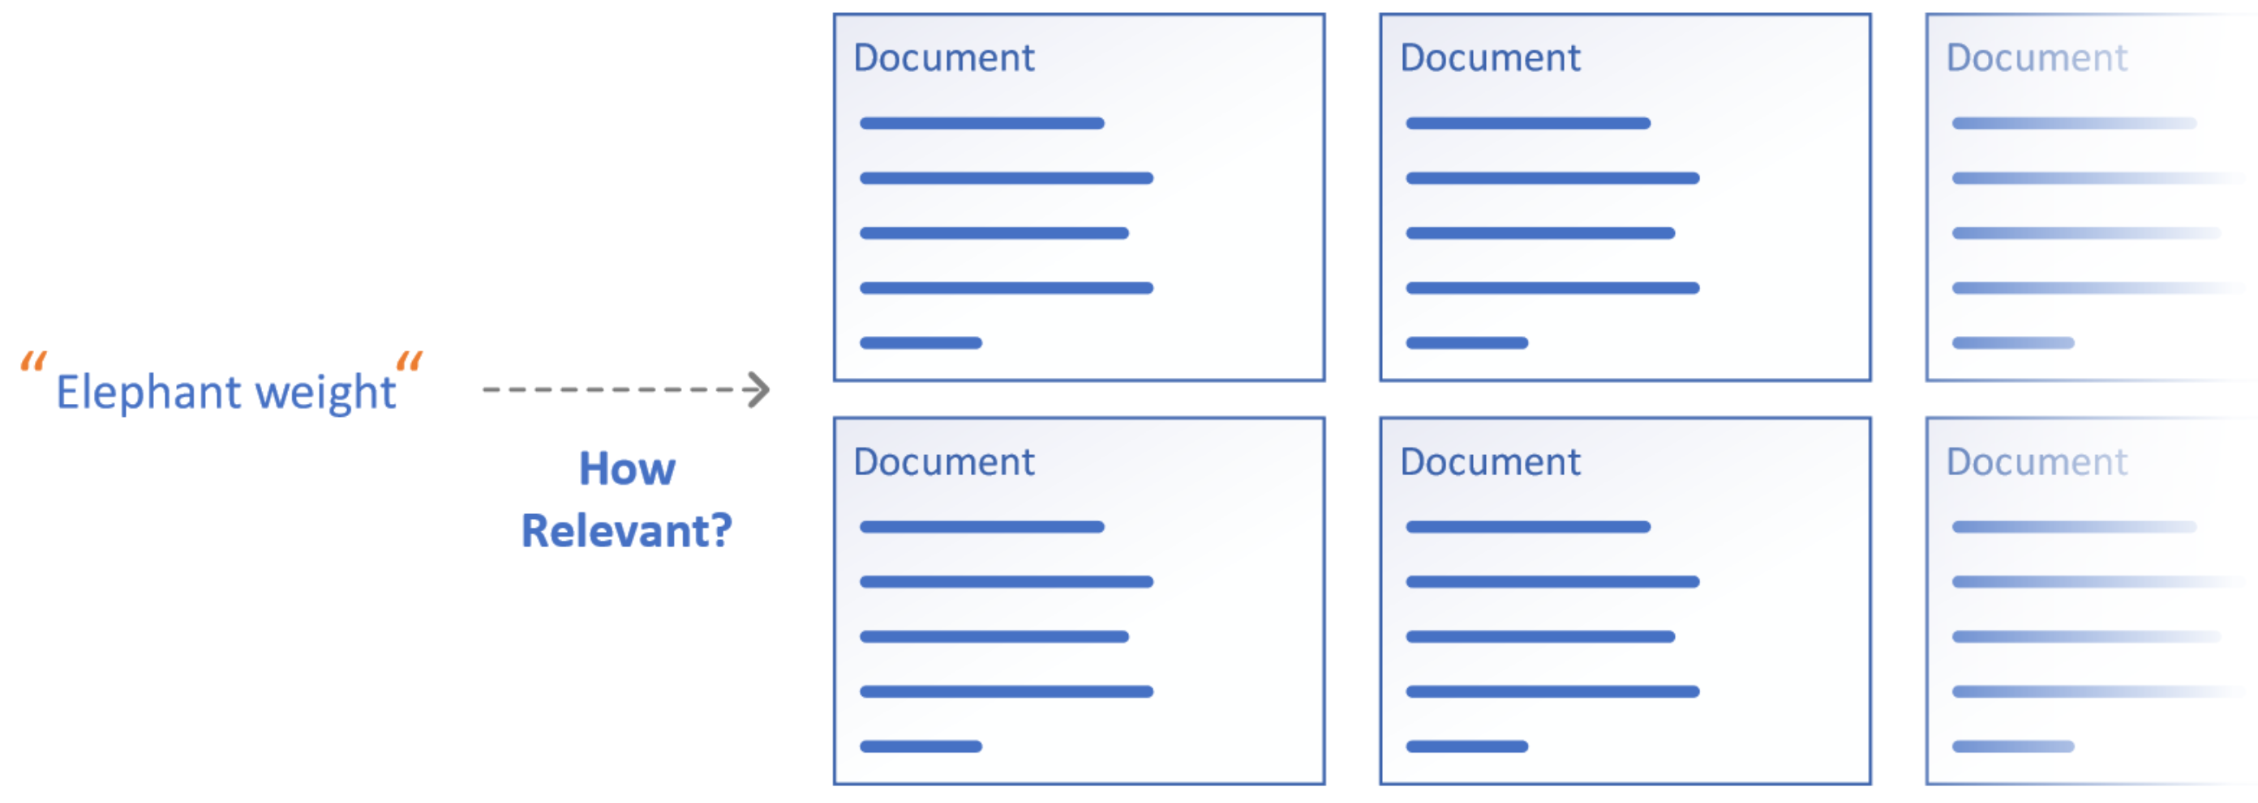
Information retrieval problem
Given a query retrieve documents from a (large) corpus of documents which are relevant to the query

Slide 5
General retrieval pipeline
Given a query
First stage retrieval from whole corpus
Re-ranking of Top N retrieved documents
First Stage Retriever
Second Stage Re-Ranking

Slide 6
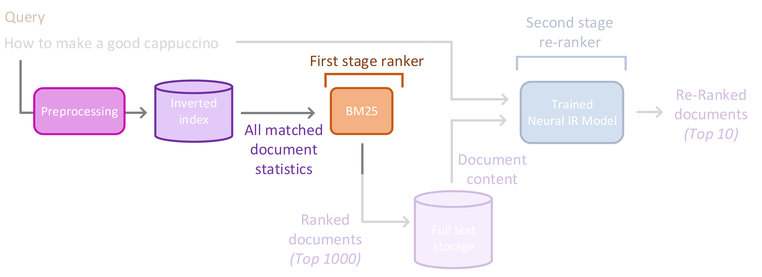
Traditional first stage retrieval with BM25
Traditional first stage retrieval is done with lexical matching using BM25

Slide 7
Dense retrieval
Dense retrieval replaces the traditional first stage
Using a neural encoder & nearest neighbor vector index
Can be used as part of a larger pipeline

Slide 8
Dense Retrieval Lifecycle
3 major phases in the dense retrieval lifecycle
Each comes with several complex choices and required techniques
Could skip if we use a pre-trained model
❶

Slide 9
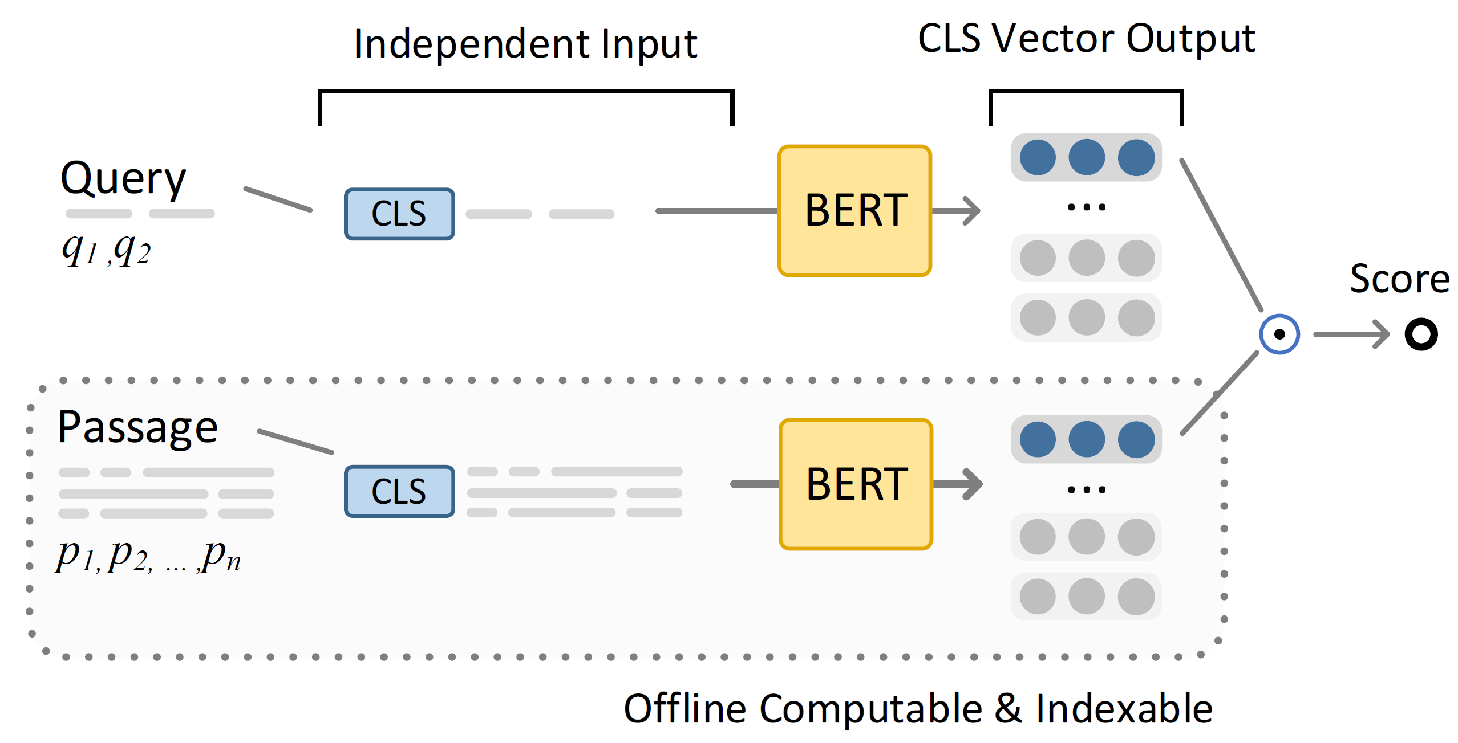
BERT_{DOT} Model
Passages and queries are compressed into a single vector
Passages are completely independent -> moves most computation into the indexing phase
Only need query encoding at runtime
Relevance is scored with a dot-product
Cosine-sim variants also exist
This allows easy use of an (approximate) nearest neighbor index

Slide 10
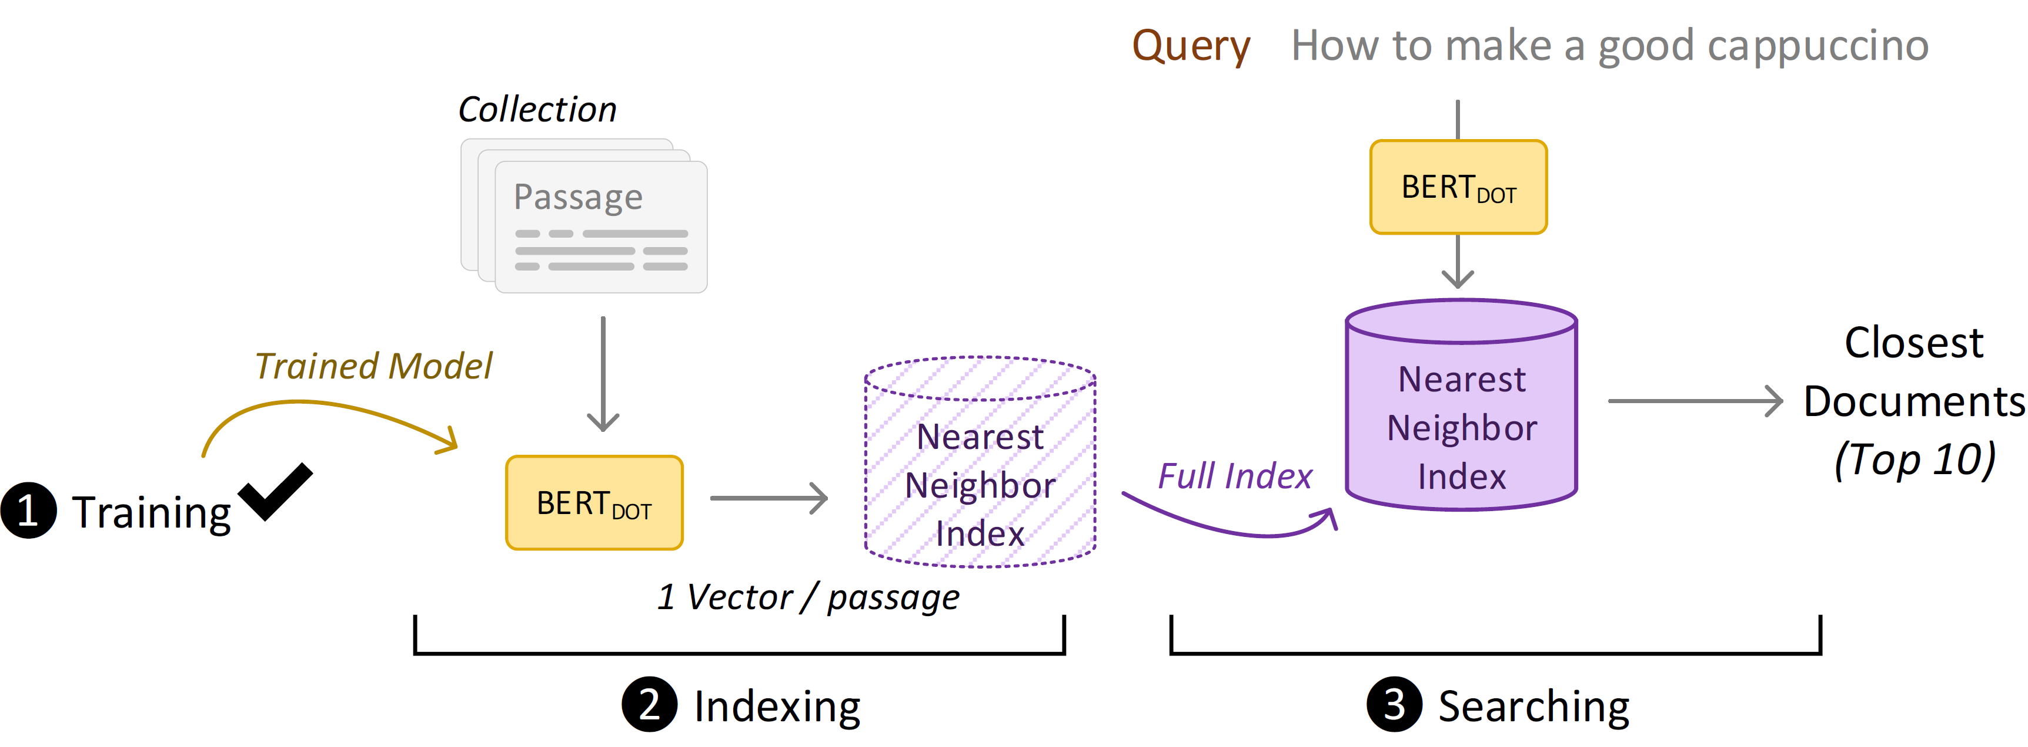
Nearest Neighbor Search
Once we have trained DPR model, we encode every passage in our collection
We save passages in an nearest neighbor index
During search we encode the query on the fly and search for nearest neighbor vectors in the passage index

Slide 11
Limitations
Dense passage retrieval models show performance gains for web search
Constrained setting in web search
Passage-to-passage retrieval
Great amount of training data
Document-to-document retrieval tasks in legal or patent domain
DPR not directly applicable due to limited input length of BERT
Small amount of training data in specific domains

Slide 12
Passage Aggregation Retrieval Model (PARM)

Slide 13
Passage Aggregation Retrieval Model (PARM)
We propose Passage Aggregation Retrieval Model (PARM) for dense document-to-document retrieval
Liberates dense retrieval models from limited input length for query and candidate document
We investigate training on limited labelled data of dense retrieval with PARM
Compare training on paragraph-level and document-level labels
We consider the document-to-document retrieval task of legal case retrieval

Slide 14
Passage Aggregation Retrieval Model (PARM)
Intuition slide: paragraph to paragarph can determine relevance of doc top doc already, therefore it is better to look at relevance on paragarph level and then aggregate! Instead of whole doc!

Slide 15
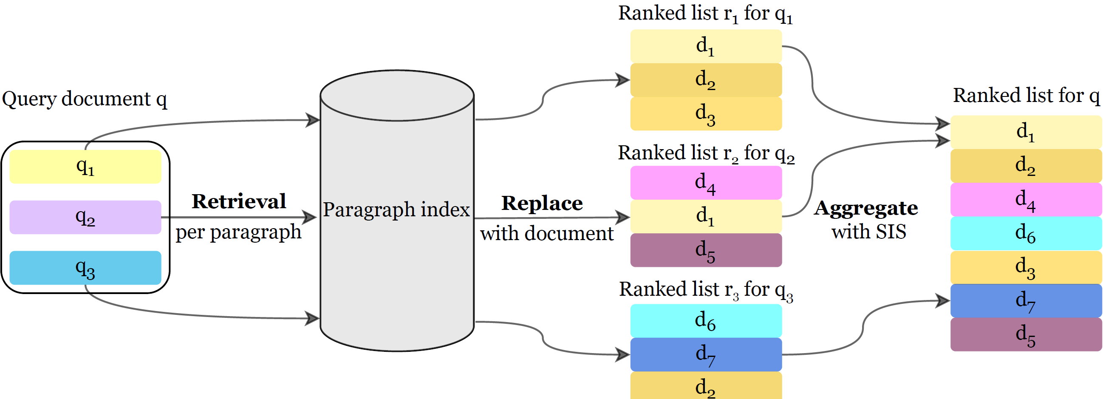
PARM Workflow
Create paragraph-level index for documents in corpus
At query time
For each query paragraph q_{i} a ranked list r_{i} gets retrieved and then aggregated to a ranked list for the whole document q

Slide 16
PARM Aggregation strategies
Interleave
first come the top documents from all ranked lists r₁, .., r_{N}
then second documents from all ranked lists
until the 𝑁th document from all ranked lists
Mean Score
Take the mean score of the document from all retrieved paragraphs

Slide 17
PARM Aggregation strategies
Count
Count the number of occurrences of a document in the ranked lists r₁, .., r_{N}
Summing Scores
Sum the scores of the paragraphs of a document occuring in the ranked lists r₁, .., r_{N}
Summing Integer Scores (SIS)
Sum the integer score of the paragraphs of a document occuring in the ranked lists r₁, .., r_{N}

Slide 18
PARM Training strategies
Dense retrieval models trained on tuples of
A query passage
A positive passage
A negative passage
We have small amount of training data for doc-to-doc retrieval task, but we have
Paragraph-level labels
Document-level labels

Slide 19
PARM Training strategies
Train DPR for PARM either on
Paragraph-level labels
The training tuples consist of the positive and negative samples to a given query paragraph
Document-level labels
Each paragraph of a positive document is considered relevant to each query paragraph, same for negative documents
Leads to less, but accurate labels from paragraph-level and a lot, but potentially noisy labels from document-level for training

Slide 20
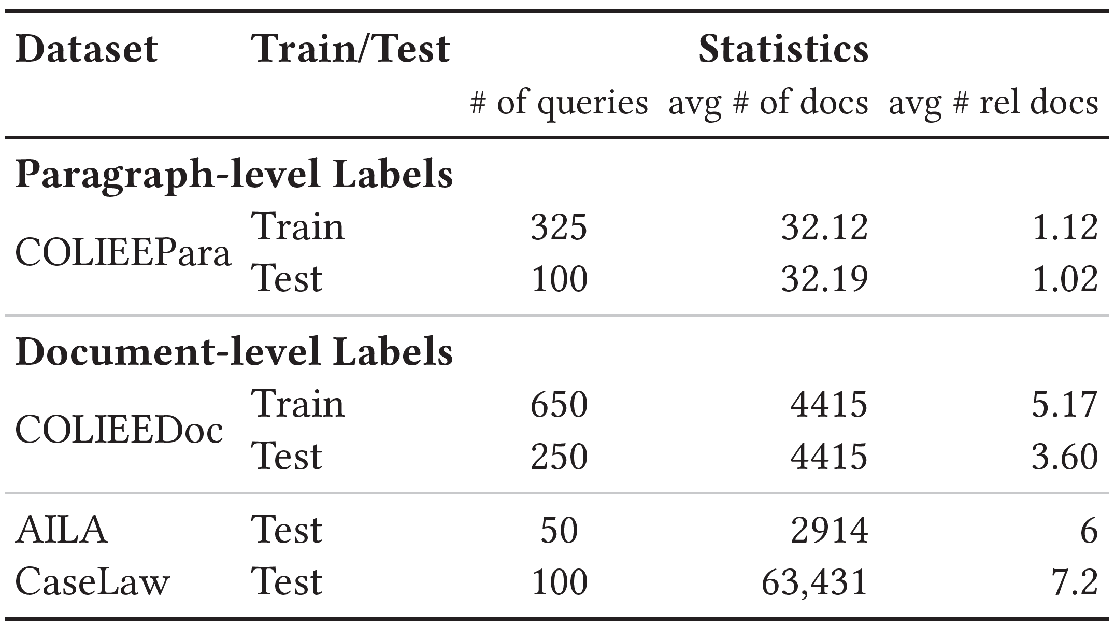
PARM Experiments
Train dense retrieval models on paragraph- and document-level labels for legal case retrieval from COLIEE workshop
Evaluate dense retrieval with PARM on three different test collections for legal case retrieval COLIEE, FIRE AILA and CaseLaw

Slide 21
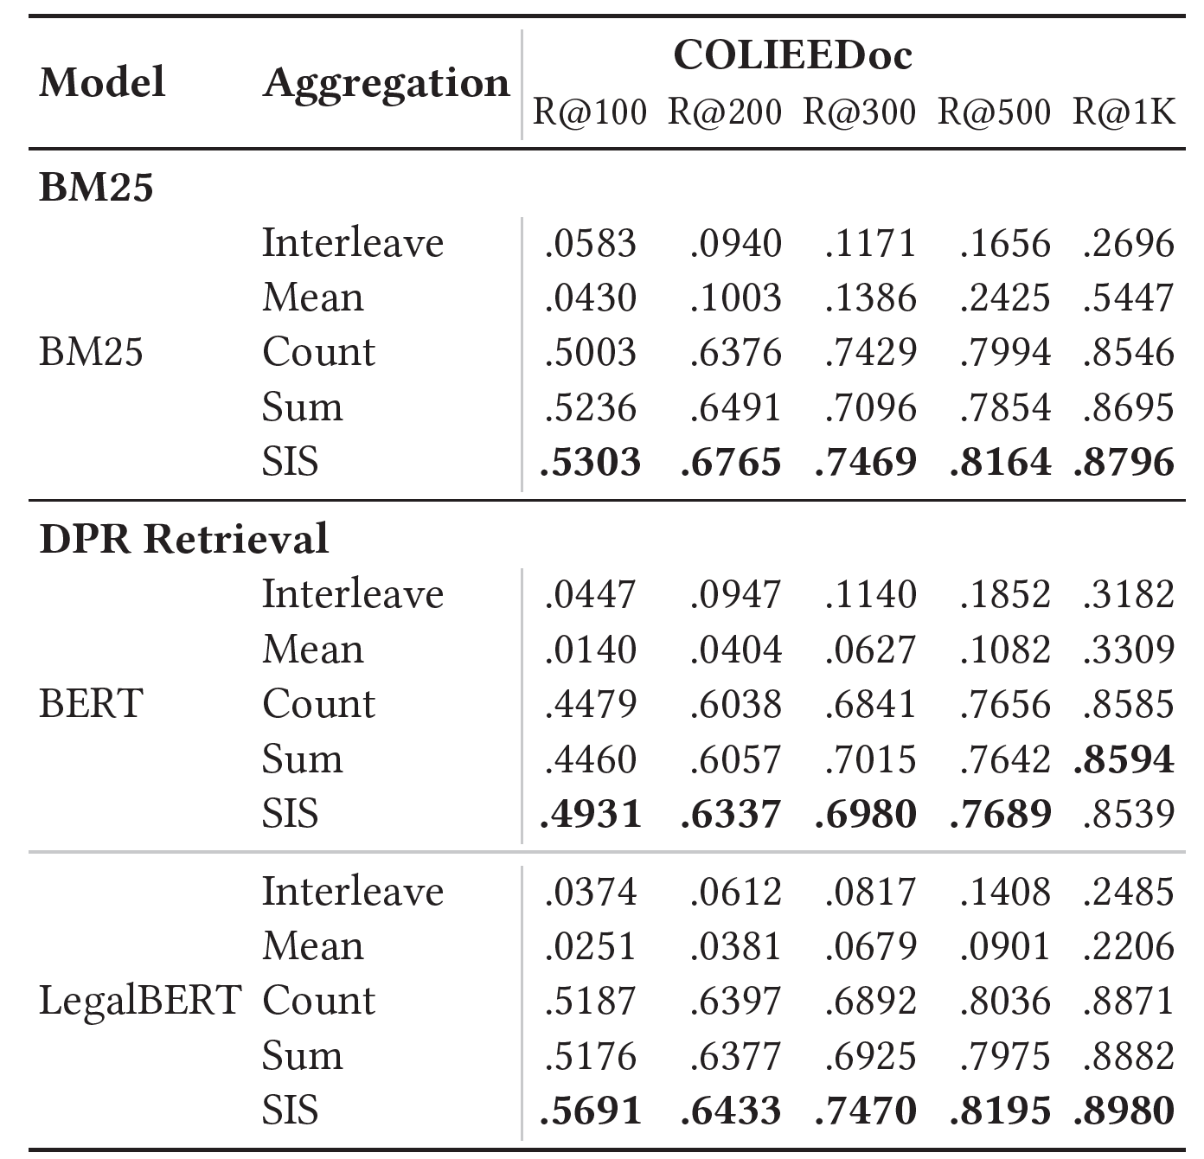
PARM RQ 1: Aggregation for PARM
RQ1: Which aggregation strategy works best for PARM?
Summing Integer Scores (SIS) shows best performance for dense retrieval with PARM

Slide 22
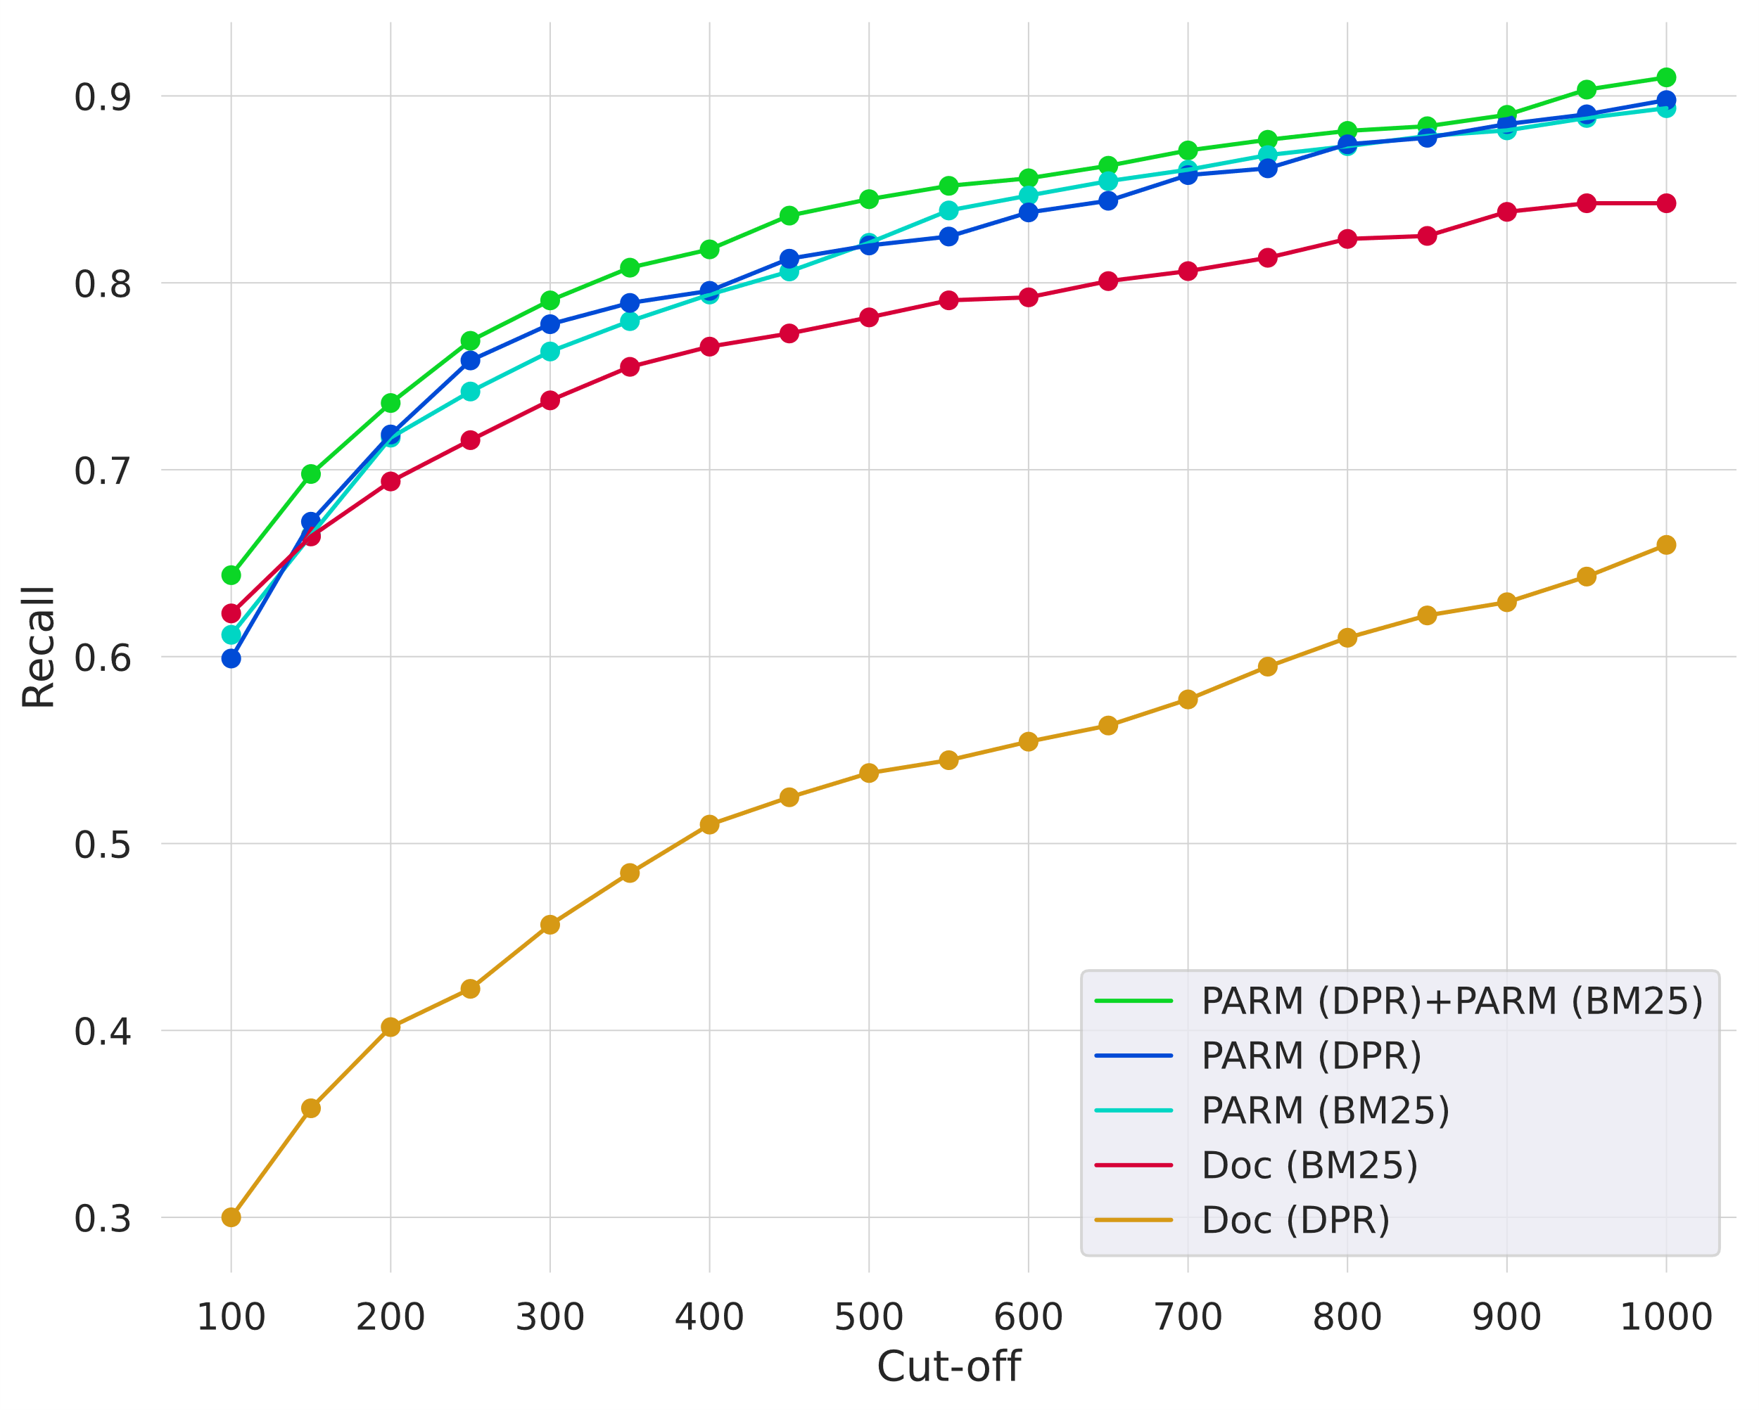
PARM RQ 2: PARM vs Document-level retrieval
RQ2: How effective is PARM for document-to-document retrieval?
PARM improves overall recall for lexical retrieval with BM25 and dense retrieval with DPR

Slide 23
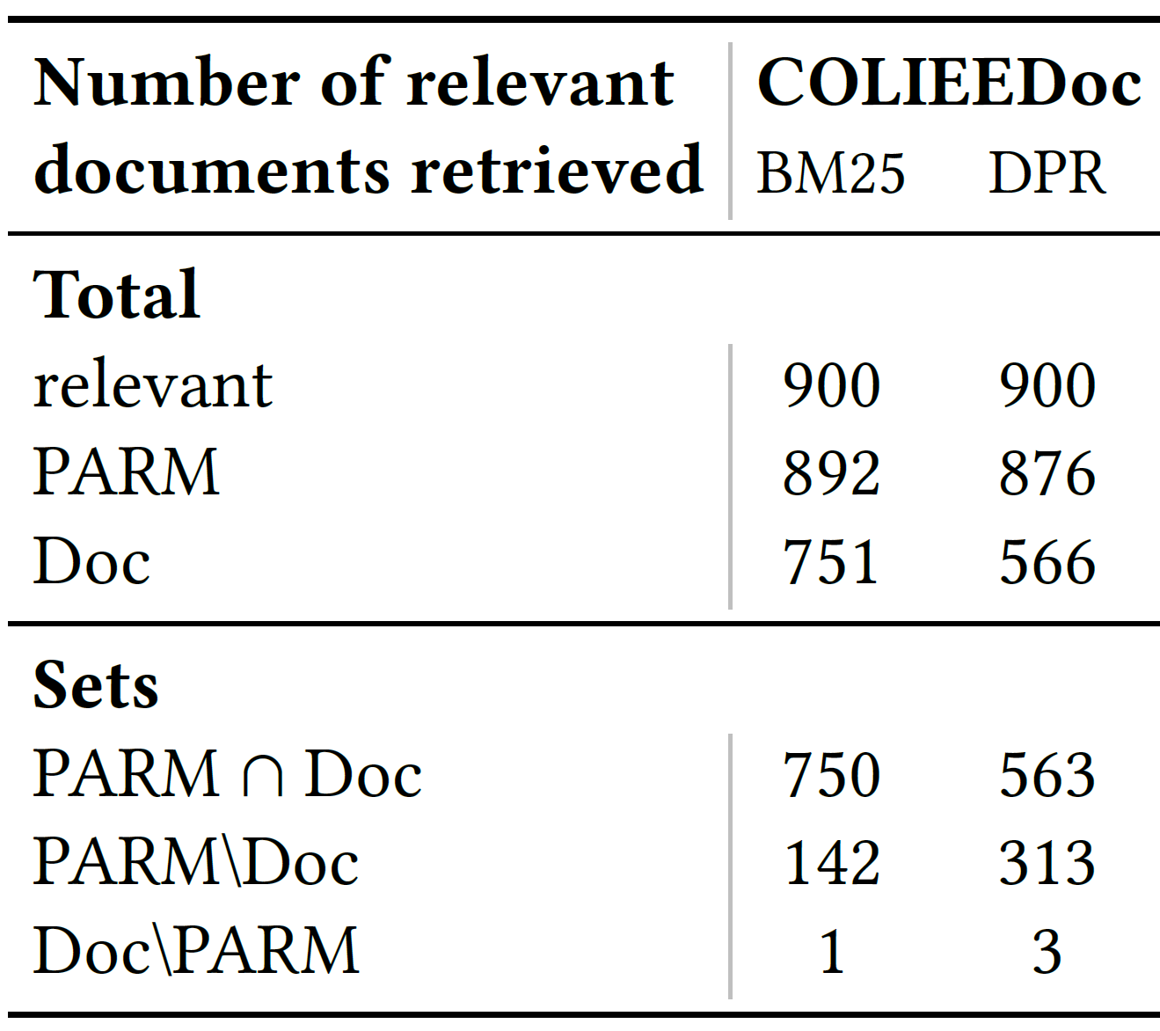
PARM RQ 2: PARM vs Document-level retrieval
RQ2: How effective is PARM for document-to-document retrieval?
PARM retrieves the same documents as document-level retrieval
PARM additionally retrieves a great amount of relevant documents

Slide 24
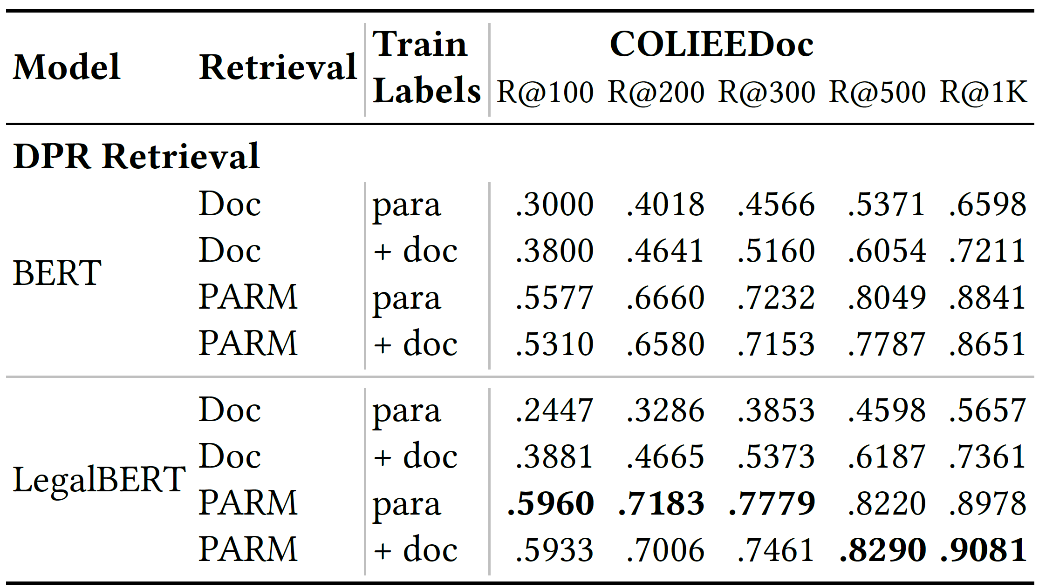
PARM RQ 3: Paragraph-level vs Document-level Labelled Training
RQ3: How can we train dense passage retrieval models for PARM for document-to-document retrieval most effectively?
Training with less, more accurate labels from paragraph-level shows higher overall retrieval performance for dense retrieval with PARM

Slide 25
PARM RQ 4: Combination of lexical and dense retrieval
RQ4: Do lexical and dense retrieval methods complement each other for document-to-document retrieval?
Combination of lexical and dense retrieval scores shows highest retrieval recall

Slide 26
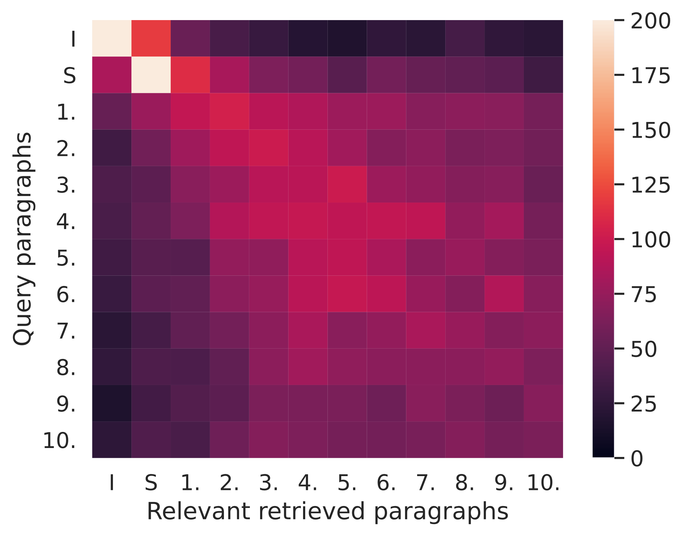
PARM RQ 5: Bias for dense retrieval with PARM
RQ5: Does dense retrieval with PARM exhibit a bias towards certain paragraphs in relevant documents?
Bias of retrieval between introductions (I) and summaries (S)
Bias towards the diagonal of claims

Slide 27
Summary: Passage Aggregation Retrieval Model
❶
Dense passage retrieval models improve first stage retrieval
❷
PARM model for document-to-document retrieval
❸
PARM improves first stage retrieval for lexical and dense retrieval models

Slide 28
❶
Dense passage retrieval models improve first stage retrieval
❷
PARM model for document-to-document retrieval
❸
PARM improves first stage retrieval for lexical and dense retrieval models
Thank You

Slide 29
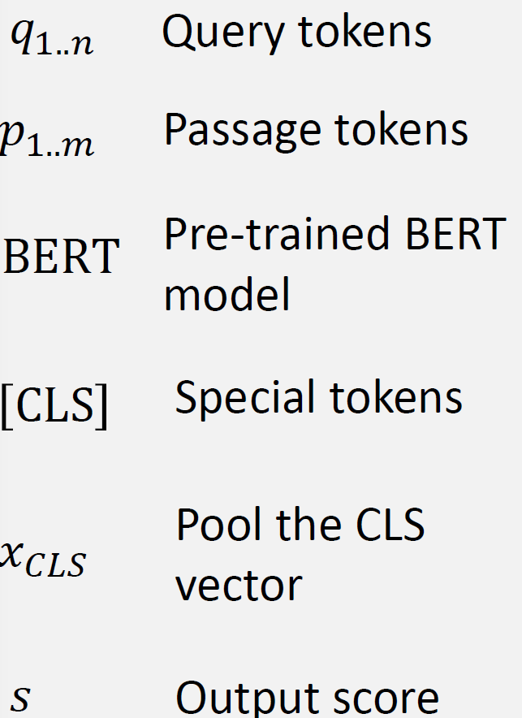
BERT_{DOT}

